Slide 1
Pre Calculus 12
Section 8.1 Geometric Sequences
i) Terms, common ratio, number of terms in a geometric sequence
ii) Geometric means
iii) Solving Algebraic sequences
© Copyright all rights reserved to Homework depot: www.BCMath.ca

Slide 2
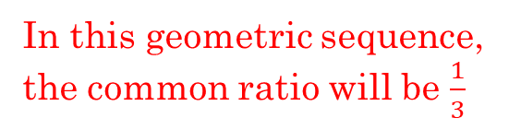
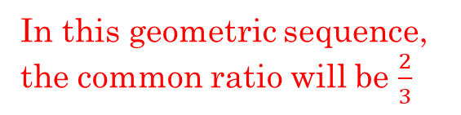
What is a Geometric Sequence?
A geometric sequence is a sequence of numbers that follows a pattern were the next term is found by multiplying by a constant called the common ratio, r.
To go from any term to the next, multiply by a common ratio “r”
If you backwards, divide by this common ratio “r”
The common ratio “MUST” be consistent, otherwise it’s NOT a geometric sequence
In this geometric sequence, the common ratio will be $\frac{2}{3}$
In this geometric sequence, the common ratio will be $\frac{1}{3}$

Slide 3
Ex: Find the next two terms in the geometric sequence and also the common ratio
To find the common ratio, you can just take any term and divide it by the previous term

Slide 4
Term Formula for a Geometric Sequence:
The first term in a geometric sequence can be defined as: $“a” or t1$
Multiply the first term by the common ratio $“r”$ to get the second term
The exponent of the “ratio” is always one less than the value of “n”
The value of the “n^{th}” term
Value of the 1st term
This is the term formula, it gives the value of the nth term in a geometric sequence
Common Ratio
- Divide any term by its previous term
The rank of the term

Slide 5
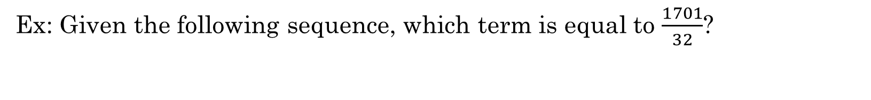
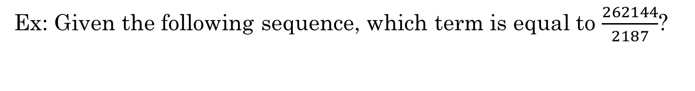
Ex: Given the following sequence, what is the value of the 12th term?
Ex: Given the following sequence, which term is equal to $\frac{1701}{32}$?
Ex: Given the following sequence, which term is equal to $\frac{262144}{2187}$?

Slide 6
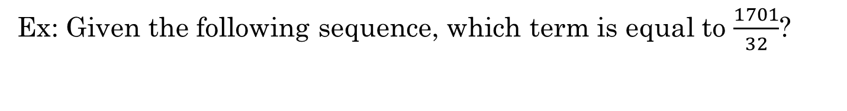

Ex: Given the following sequence, what is the value of the 12th term?
Use the formula to find the 12th term: $tn=a×r^{n−1}$
$$a=6, n=12, r=2$$
Ex: Given the following sequence, which term is equal to $\frac{1701}{32}$?
We know that the last term is equal to 1701/32
Use the formula to find the value of “n”: $tn=a×r^{n−1}$

Slide 7
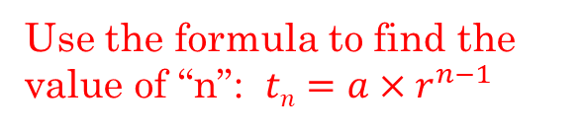
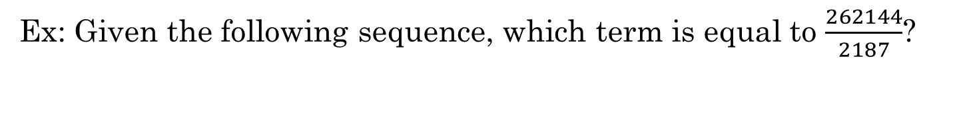
Ex: Given the following sequence, which term is equal to $\frac{262144}{2187}$?
First find the value of “r”
Use the formula to find the value of “n”: $tn=a×r^{n−1}$
The 10th term is equal to 262144/2187

Slide 8
Formulas and Key Ideas
The common ratio can be a fraction, radical, positive, negative, or even an algebraic expression
When given two terms in a geometric sequence, the larger term is equal to the smaller term multiplied by the common ratio several times
Ie: Suppose you are given terms t₃ and t₈ in a geometric sequence
To go from the third term to the eighth term, we would multiply by the common ratio 5 times!!
The value of the “n^{th}” term
The difference in “n” between the two terms
The value of the “n+k^{th}” term

Slide 9
Ex: the third term of a geometric sequence is 27 and the sixth term is 64. Find the common ratio:
Ex: Given the following sequence, find the 20th term:
Ex: Given and find the common ratio and the first term:

Slide 10
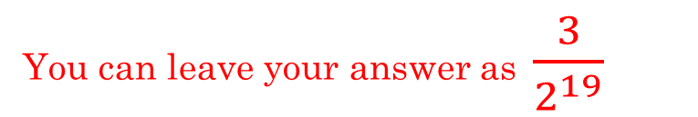
Ex: Given the following sequence, find the 20th term:
You can leave your answer as $\frac{3}{2^{19}}$

Slide 11
Ex: the third term of a geometric sequence is 27 and the sixth term is 64. Find the common ratio:
Each term in the sequence is equal to the
previous term multiplied by the common ratio:
The sixth term is equal to both 64 and 27r³
To find the terms in between, just multiply 27 by the common ratio.
© Copyright all rights reserved to Homework depot: www.BCMath.ca

Slide 12
Ex: Given and find the common ratio and the first term:
Now solve for “a”, the first term
The sixth term is equal to the fourth term multiplied by the common ratio 4 times
Let’s check the answers by finding the terms in the sequence:
With two values of “r” there will be two different sequences

Slide 13


Ex: Given and find the common ratio and the first term:
For $n=\frac{2}{3}$
For $n=−\frac{2}{3}$
With two common ratios, you will have TWO different sequences!!!

Slide 14
Ex: the Fourth term of a geometric sequence is 27 and the seventh term is $−64$. Find All 7 terms:
Ex: Given a geometric sequence with $t3 = 12 and t6=1.5$. What is the value of $t8$?
Now find “t8”
Use the formula
to find the common ratio first
NOTE: when dividing by a fraction, just multiply by the reciprocal
To find the other terms, just multiply or divide the common ratio

Slide 15
Ex: If
forms a geometric sequence.
Solve for x.
The new sequence formed is 1 , 2 , 4 which is a geometric sequence.
Ex: The first and second terms of a geometric sequence have a sum of 15, while the second and third terms have a sum of 60. Use an algebraic method to find all three terms.

Slide 16
Ex: The first and second terms of a geometric sequence have a sum of 15, while the second and third terms have a sum of 60. Use an algebraic method to find all three terms.
Let the first three terms be
We will find r from the following system of two equations in two unknowns.
Dividing equation (2) by equation (1)
we can eliminate a.

Slide 17
III) Terms & FINAL equation:
Double Time: The time it takes a population or the weight of an object to double its size or value
Half – Life: The time it takes a population or object to depreciate to half its size or value
Ie: Time it takes a
population to double
Ie: Time required to
reach Half - Life
Annually: L = 1
© Copyright all rights reserved to Homework depot: www.BCMath.ca

Slide 18
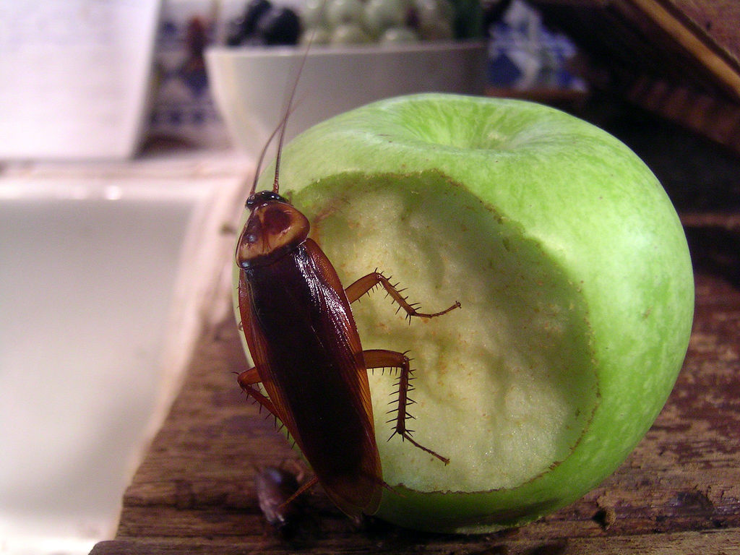
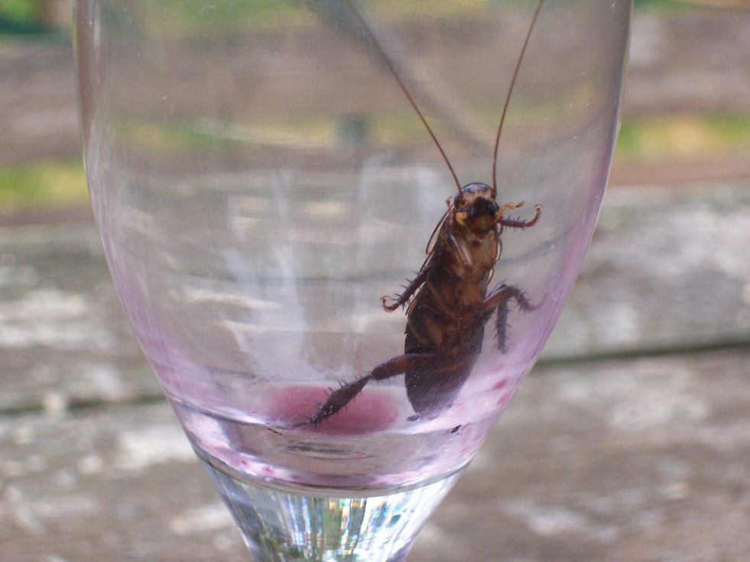
Ex: Cockroach Question:
If a colony of 2 cockroaches doubles every day, how many cockroaches will there be after 1 week?
© Copyright all rights reserved to Homework depot: www.BCMath.ca

Slide 20
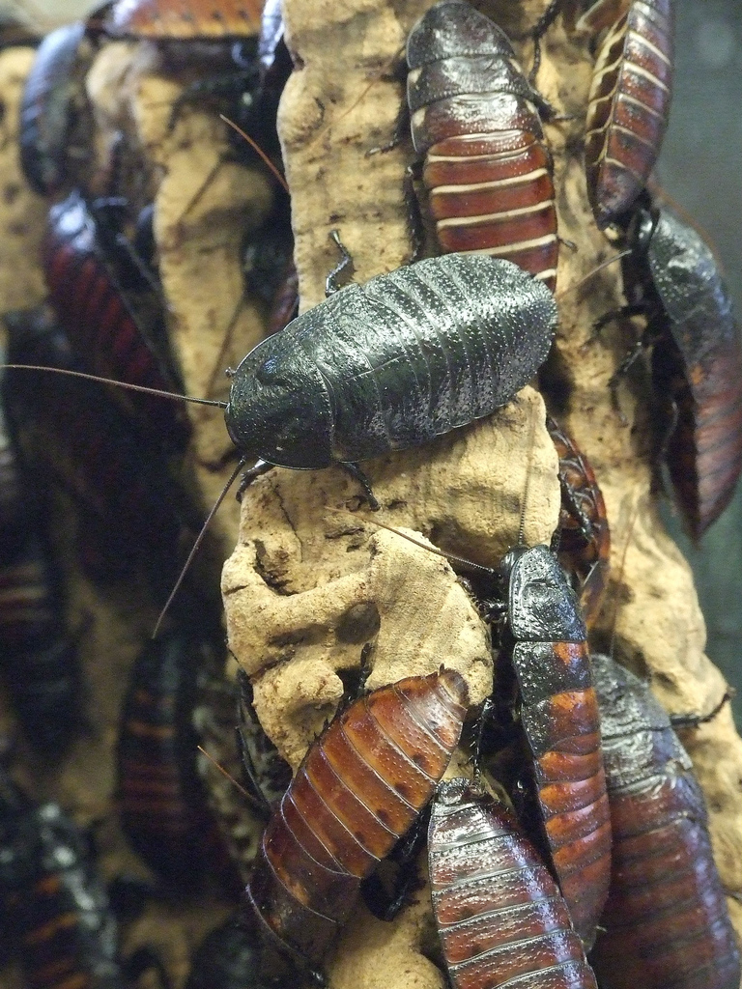
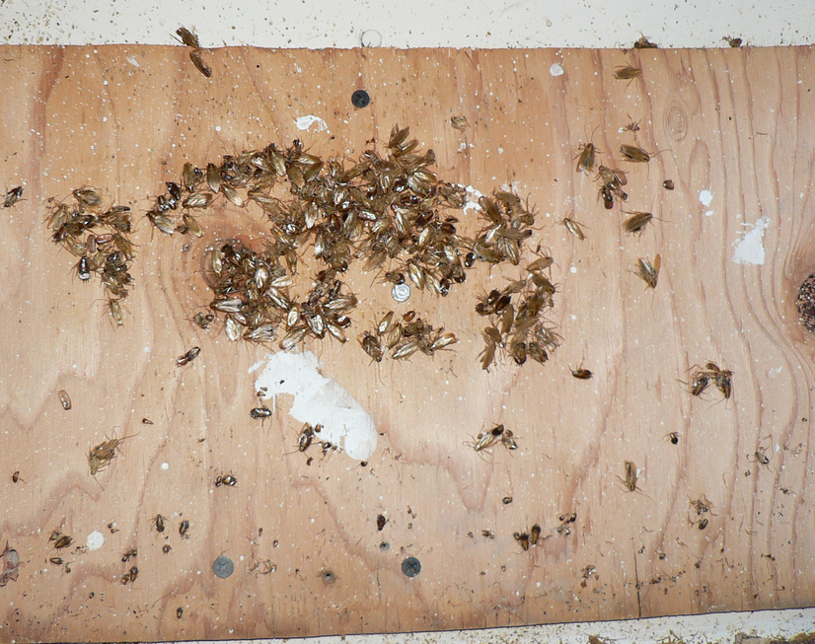
© Copyright all rights reserved to Homework depot: www.BCMath.ca

Slide 21
© Copyright all rights reserved to Homework depot: www.BCMath.ca

